Slide 1





Dance School
Web Application Presentation
April 7, 2025

Slide 2


Ho Ka Pik - Edna (4)
Yuen Ka Ki - Rainbow (8)
Lau Tim - Tim (16)
Meet the Team

Slide 3


WHY ?
S
olving Multiple Tasks
Most dance school management systems fail to provide an integrated and efficient platform for managing students, teachers, courses, and venue rentals. This results in management challenges and cumbersome processes for both students and teachers.

Slide 4











Architecture Diagram
FRONTEND
BACKEND
DATABASE
CLOUD PLATFORM

Slide 5
User Management
Provides login and registration features. Role-based access control after login.
Course Enrollment
Feature Overview
Browse available courses, enroll, and manage class schedules easily.
Studio Booking
Check availability, reserve, and manage dance studio spaces effortlessly.
Product Purchase
Browse, select, and purchase dance-related products through an intuitive interface.
Shopping Cart
Add, remove, and review selected items before completing the purchase.
Email Verification & Google Login
Verifies accounts and enables quick, secure login.
Special Event Apply
Competition Apply from and Manage table.

Slide 6



Course Enrollment
Easy course search and registration for customers.
Boosts customer motivation to sign up.
Resolves issues with availability checks and complex payments.
Search Course
Add to Cart
Confirm
Login page

Slide 7
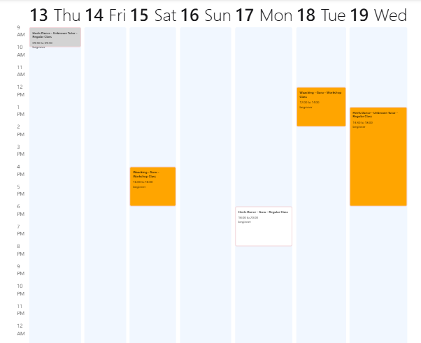
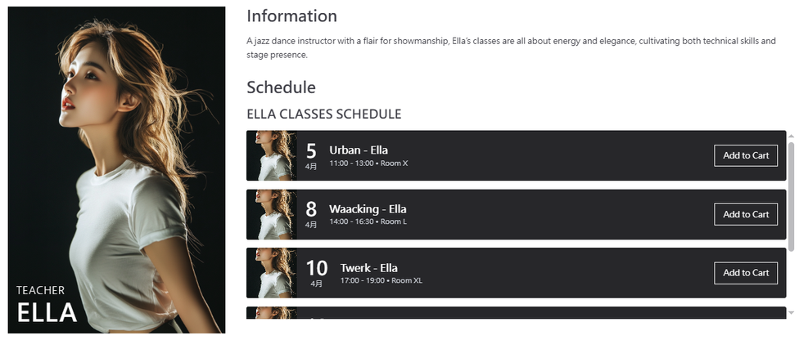
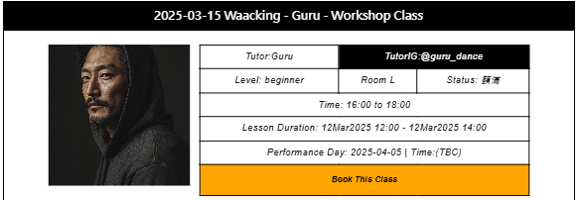
Multiple Entry
TEACHER'S PROFILE
On the teacher's profile page, users can click on a teacher's name to see the courses they teach.
CALENDAR SCHEDULES
Users can view available courses directly on the calendar for easy access to schedules.

Slide 8
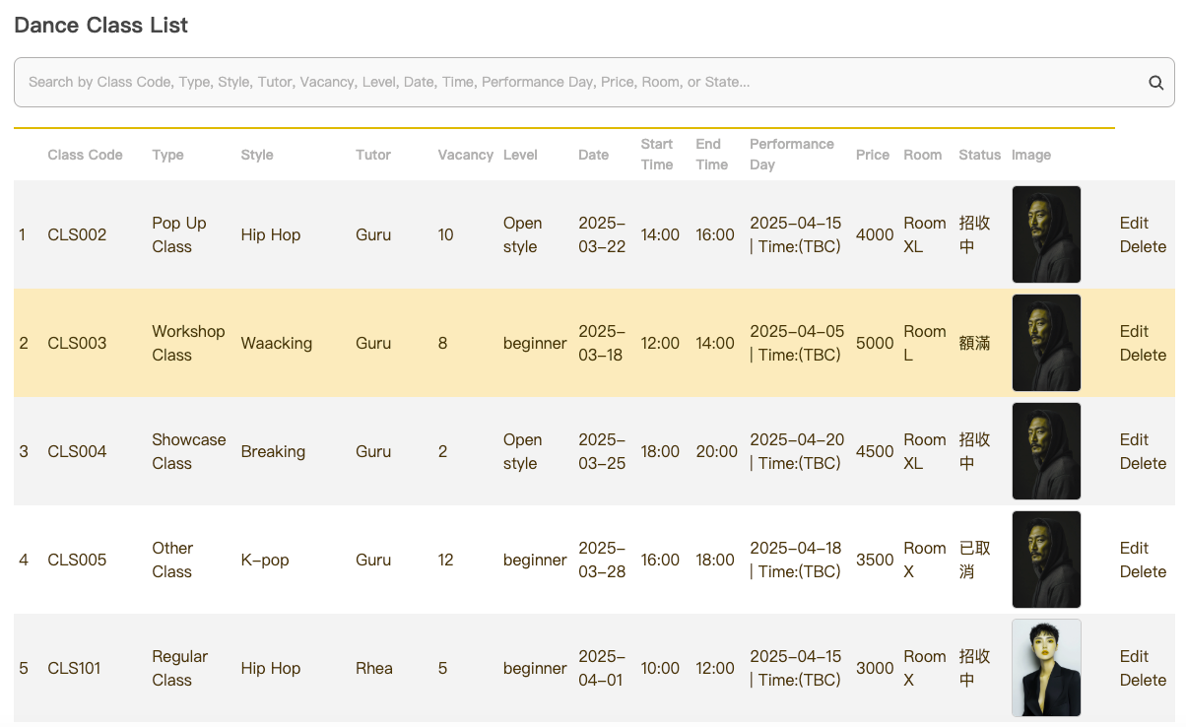
Course Management
ADMIN
On the admin's page can search and delete of all the classes.

Slide 9

Studio Booking
Instant room availability display
Reduces inquiries between customers and businesses
Check Date
Setect Date
Confirm available
Add to Cart

Slide 10


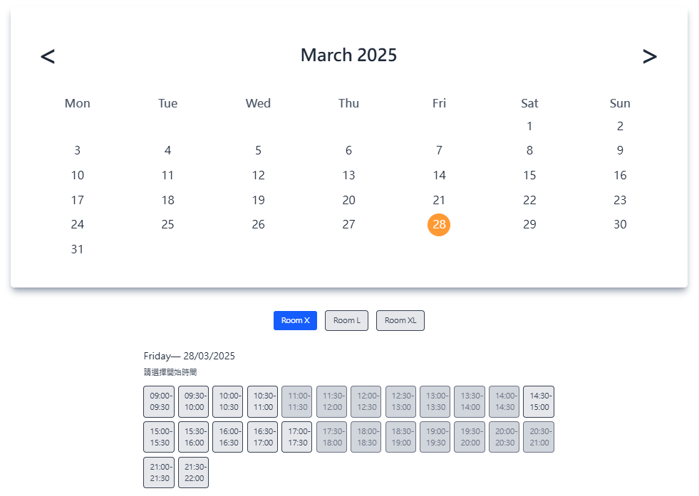
Visual
Representation
Real-time booking
Simplifies booking process
Reduces admin workload
Clear and intuitive

Slide 11



User case of Register
Personalized Services: Access to member-only features like course registration, shopping, and booking.
Enhanced Security: Verify user identity to prevent unauthorized access.
Better Interaction: Offer community features and course reviews for more engagement.
Registration page
Enter email and password
System validates
Email Verification or Google Login
Login page

Slide 12
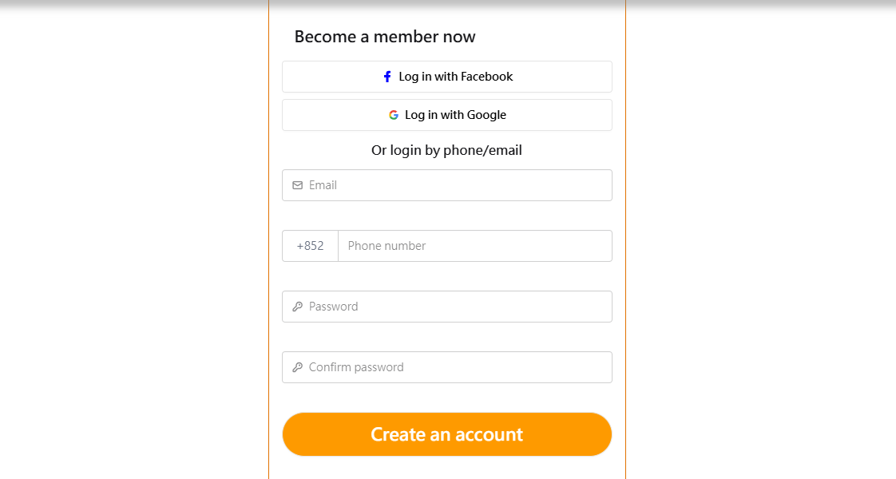
Email Verification
After user registration, a verification email is sent.
Users must click the verification link to complete registration.
Ensures account validity and security.
Login with Google
Supports quick login using a Google account.
Simplifies the login process.
Provides a more convenient user experience.

Slide 13
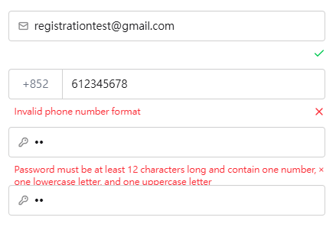
Validation & Encryption
Supports Registration for Different Roles
Validation to prevent duplicate registrations
Strict password requirements
Secure password storage using BCrypt encryption.

Slide 14



User Management
Sets different access and management permissions based on user roles
STUDENTS
TEACHERS
STAFF
View enrollment records
Check class schedules
View class schedules
Check enrollment status
Manage room rentals， courses and Monitor student attendance

Slide 15


User case of Login
Enter Credentials: Users enter their username and password
Send Request: Sends the username and password to 3 collections to search for the corresponding user.
Verify Password: If a user is found, the input password is encrypted and compared with the password stored in the database.
Generate Token: Generates a JWT token and stores it in the browser.
Enter Credential
Send Request
Verify Password
Generate Token

Slide 16
Access Control
Restricts different roles to access specific URLs.
Public URL
Accessible by everyone.
Private URL
Accessible only by authorized roles
Home Page : http://localhost:3000/
Tutor : http://localhost:3000/tutor Dance Path Dance Path : http://localhost:3000/dance-path Score : http://localhost:3000/member-score
Rent : ttp://localhost:3000/danceClass/roomRental
Member :
http://localhost:3000/member/information
Teacher :
http://localhost:3000/teacher/information
Staff :
http://localhost:3000/staff/information

Slide 17





Next Work to Do
Instant Messaging
Online Payment
Implement real-time communication features.
Integrate online payment system for easy transactions.
Interactive Features
Multimedia Support
Add interactive elements for user engagement
Provide support for multimedia content such as videos, images, and audio.

Slide 18

DEMO

Slide 19




THANK YOU
www.XtraLab.com

